Slide 1


Safe Aquifers: Investigating Water Potability Trends for Public Health
This presentation explores the use of predictive models to determine the potability of water sources, helping ensure the availability of safe and clean drinking water

Slide 2



Introduction
Target Variable: Potability
Modeling and Evaluation
Ensuring Safe Water
This project focuses on predicting whether water from a source is safe for human consumption.
The goal is to build and evaluate models that can accurately predict the water potability outcome.
Accurately predicting water potability is crucial for providing safe drinking water to communities.
This introductory slide sets the stage for a project focused on predicting water potability, a key factor in ensuring safe and reliable drinking water for the public.

Slide 3
Problem Statement
Water Quality Parameters
Analyze various physical, chemical, and biological parameters that determine water potability, such as pH, turbidity, dissolved oxygen, and presence of coliform bacteria.
Predictive Modeling
Develop a robust machine learning model that can accurately predict water potability based on the collected water quality data.
Stakeholder Engagement
Enable stakeholders, including water utilities, regulatory authorities, and community representatives, to make informed decisions about water treatment and distribution to ensure safe drinking water.
Informed Decision-Making
Provide a tool that allows stakeholders to assess water potability and take appropriate actions to address any water quality issues, promoting public health and environmental sustainability.

Slide 4
Dataset Dictionary
pH
Turbidity
Chlorine
Measure of acidity or basicity of the water sample, ranging from 0 to 14, with 7 being neutral.
Measure of the cloudiness or haziness of the water, caused by suspended particles.
Measure of the free chlorine content in the water, used for disinfection and water treatment.
Total Dissolved Solids (TDS)
Nitrate
Potability
Measure of the concentration of nitrate ions, which can indicate agricultural or wastewater pollution.
Indicator of whether the water is safe for human consumption, based on various water quality parameters.
Measure the total amount of dissolved substances in the water, including minerals, salts, and organic matter.

Slide 5
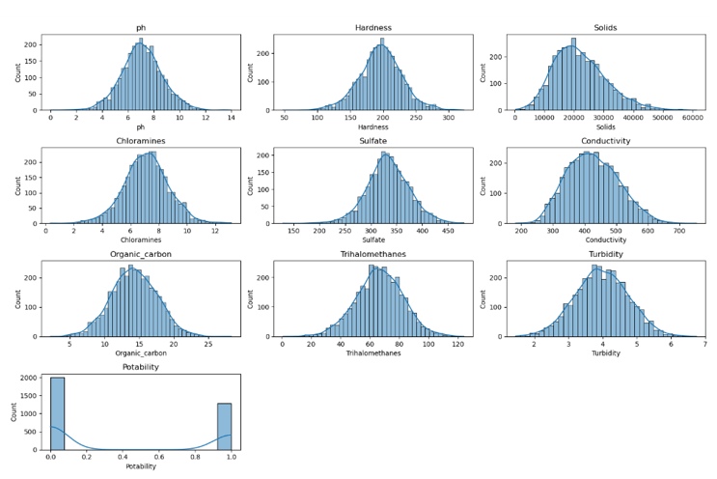
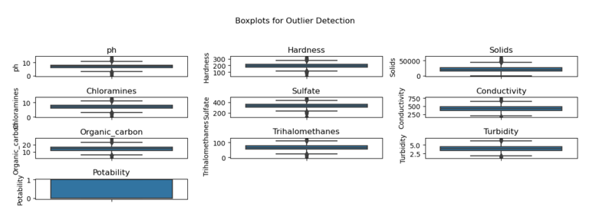
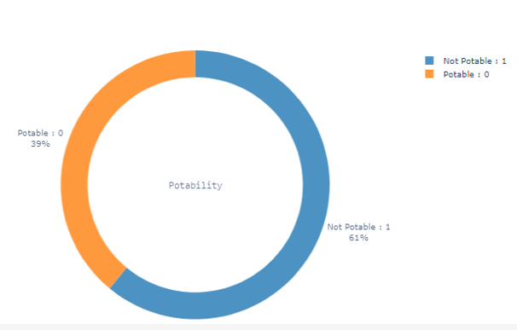
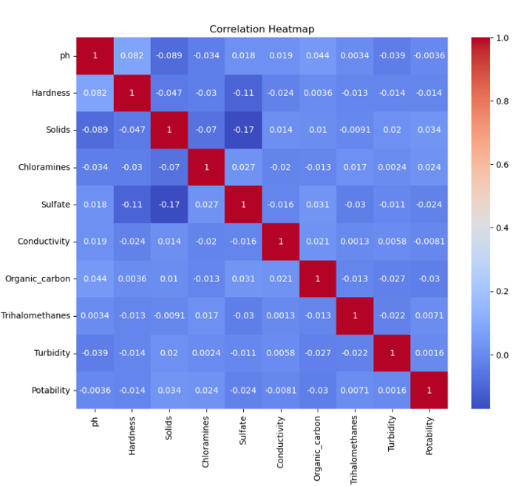
Data Exploration
HISTOGRAM OF NUMERIC VARIABBELS
BOX PLOT OF WATER QUALITY VARIABLES
DONUT CHART OF POTABILITY DISTRIBUTIONS
HEATMAP OF CORRELATION MATRIX
Histograms reveal varied distributions of water quality parameters, indicating both normal patterns and potential contamination or extreme conditions
Boxplots reveal varied distributions and potential skewness in water quality parameters, aiding in data preprocessing and model-building decisions
A Donut chart shows 61% non-potable and 39% potable water samples, highlighting dataset imbalance.
Heatmap shows generally weak correlations among water quality parameters and with potability, indicating the complexity of predicting water potability.

Slide 6


Data Preprocessing
Missing Value Imputation
Dataset Balancing with ADASYN
Effective Model Training and Evaluation
Employed various imputation techniques, such as mean/median imputation, to handle missing values in the dataset.
Used the ADASYN (Adaptive Synthetic Sampling Approach for Imbalanced Learning) method to generate synthetic samples and balance the class distribution in the dataset.
Ensured the preprocessed dataset with imputed missing values and balanced classes would enable effective training and reliable evaluation of the predictive model.
The data preprocessing steps of missing value imputation and dataset balancing using ADASYN were crucial to preparing the data for effective model training and evaluation

Slide 7
Model Building and Evaluation
Accuracy, AUC, Recall, Precision, and F1-Score
66%
65%
64%
76%
73%
73%
74%
SVM
KNN
Decision Tree
Random Forest
CatBoost
LightBGM
XGBoost

Slide 8
Model Evaluation After Hyperparameter Tuning
Model | Accuracy Score
Random Forest Classifier | Before tuning, the Random Forest model achieved an accuracy of 75.80% with an F1-score of 0.75. After tuning, the accuracy slightly decreased to 75.43%, but the F1-score remained consistent at 0.75.
CatBoost | Before tuning, CatBoost had an accuracy of 73.58% and an F1-score of 0.74. After tuning, the accuracy improved to 75.31%, and the F1-score increased to 0.75.
LightGBM | LightGBM achieved an accuracy of 73.09% with an F1-score of 0.73. Following hyperparameter tuning, its accuracy rose to 75.68%, and the F1-score improved to 0.76.
XGBoost | XGBoost's initial accuracy was 74.69% with an F1-score of 0.76. After tuning, the accuracy decreased to 72.47%, and the F1-score dropped to 0.72.
Model
Accuracy

Slide 9




Conclusion
Top-Performing Model
Accuracy and Reliability
Random Forest emerged as the overall top-performing model, excelling in accuracy, AUC, precision, and F1 score, with a high Kappa coefficient and MCC.
The high accuracy, AUC, precision, and F1 score of Random Forest indicate its reliability in predicting water potability.
Strong XGBoost Performance
Robust Metrics
XGBoost also demonstrated strong performance, particularly in recall and MCC.
The high Kappa coefficient and MCC for Random Forest suggest its robustness and ability to handle imbalanced data.
The results demonstrate the effectiveness of ensemble learning techniques, particularly Random Forest and XGBoost, in accurately predicting water potability. These models provide a reliable and robust solution for this important environmental challenge.

Slide 10
Model Deployment
Model Selection
Predictive Accuracy
Model Robustness
The Random Forest model is recommended for deployment due to its consistent performance and reliability in predicting water potability.
The Random Forest model has demonstrated high accuracy in predicting whether water is potable, making it a reliable choice for deployment.
The Random Forest model is robust to outliers and can handle diverse input data, ensuring reliable predictions even with varying water quality parameters.
Deployment Considerations
Interpretability
The Random Forest model can be easily integrated into real-world water treatment systems, allowing for seamless monitoring and decision-making processes.
The Random Forest model's decision-making process is more transparent and interpretable than other complex models, facilitating understanding and trust in the predictions.

Slide 11
Challenges and Opportunities
DATA QUALITY AND PREPROCESSING
Ensuring high-quality, representative data for training the predictive model to enhance accuracy and reliability.
FEATURE ENGINEERING AND SELECTION
Identifying the most relevant variables and creating meaningful features to improve the model's predictive power.
MODEL COMPLEXITY AND INTERPRETABILITY
Balancing model complexity to achieve high accuracy while maintaining interpretability and explainability.
REAL-TIME DEPLOYMENT AND SCALABILITY
Ensuring the model can be efficiently deployed and scaled to handle large-scale, real-time water quality monitoring applications.
EXPANDING USE CASES
Exploring the potential for the predictive model to be applied to other water-related applications, such as wastewater treatment and agricultural irrigation.

Slide 12





Incorporate Customer Sentiment Analysis
Enhance Feature Engineering with Geospatial Data
Future Enhancements
Leverage Ensemble Modeling Techniques
Improve Real-Time Churn Prediction Capabilities

